Slide 1
VI curve trace install and use SOP for windows

Slide 2
Background
For quicker and precise test of VI curve trace, we just need a power supply, GPIB-USB cable, PC and software. Below will introduce the install and use method of the software.

Slide 3
Install files DL
Server route : \\172.28.138.39\ee\MLB EE

Slide 4
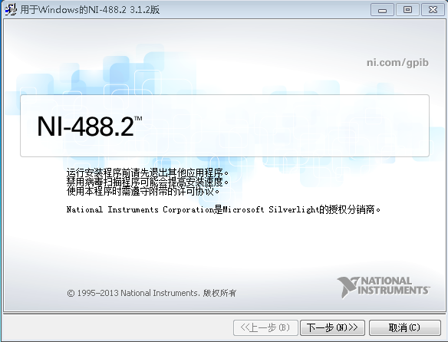
Install step 1
1. Install NI-488.2, Route: D:\VI Curve trace measurement\Windows\NI-488.2\3.1.2

Slide 5
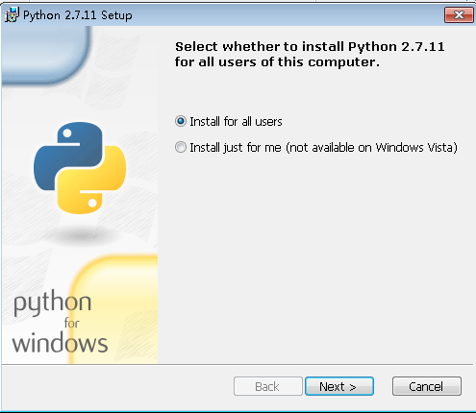
Step 2
2. Install python-2.7.11.amd64 if it is 64 byte system, 32 byte system please install python-2.7.11, Route: D:\VI Curve trace measurement\Windows

Slide 6
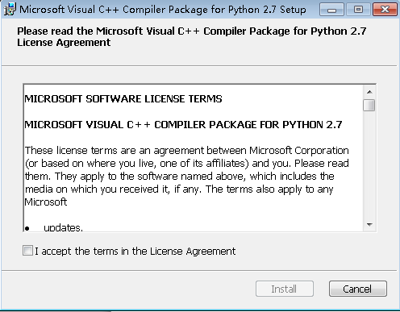
Step 3
3. Install VCForPython27, Route: D:\VI Curve trace measurement\Windows

Slide 7
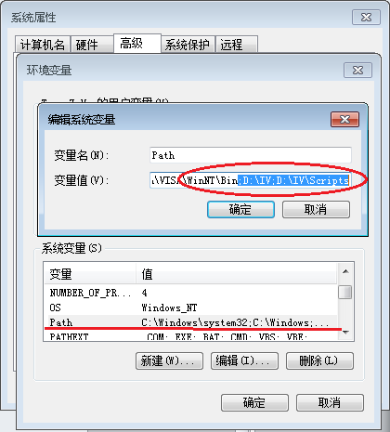
Step 4
Modify environment variables of path. You just need add some words shown as below, it is different according to your install route, example, if install in “D\IV”, it should like below ,(;D:\IV;D:\IV\Scripts)

Slide 8
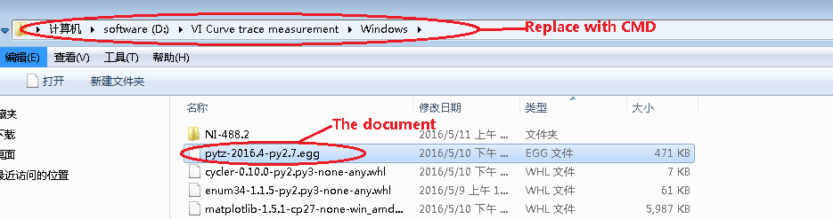
Step 5
5. easy_install pytz-2016.4-py2.7.egg. Firstly，find the position of “pytz-2016.4-py2.7.egg” document , replace the route with CMD, and press enter.

Slide 9
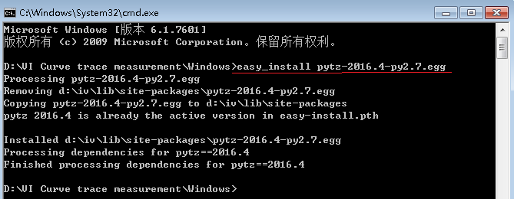
Run commnd easy_install pytz-2016.4-py2.7.egg, the document will be installed.

Slide 10
Step 6 to 12
6. pip install six-1.10.0-py2.py3-none-any.whl
7. pip install numpy-1.11.0-cp27-none-win32.whl
8. pip install cycler-0.10.0-py2.py3-none-any.whl
9. pip install enum34-1.1.5-py2.py3-none-any.whl
10. pip install pyparsing-2.1.1-py2.py3-none-any.whl
11. pip install python_dateutil-2.5.3-py2.py3-none-any.whl
12. pip install matplotlib-1.5.1-cp27-none-win32.whl

Slide 11
Same way as step 5, and please install step by step
Notice 1: you should find the exact position of the document before going CMD Window, otherwise, it will cannot find the document .
Notice 2: For 32 byte system command is pip install numpy-1.11.0-cp27-none-win32.whl, if it is 64 byte system, the command should be pip install numpy-1.11.0-cp27-none-winamd64.whl, please notice the difference.

Slide 12
Step 13 and 16
13. Unzip PyVISA-1.8.tar, Go to PyVISA-1.8 folder
14. python setup.py install
15. Unzip pandas-0.18.1.tar, Go to pandas-0.18.1 folder
16. python setup.py install
Same way as step 5, just need to unzip the two files before install.

Slide 13
Congratulation, install is done!

Slide 14
How to use Tool
1. Open command line window
2. python CurveTrace.pyc "VI curve trace" -0.9 0.9 0.05
"VI curve trace" --- Test item naming
-0.9 --- Start of measurment voltage
0.9 --- End of measurement voltage
0.05 --- Measurment Step

Slide 15
Notice for use
Notice1: you can find the curve in the install documents obviously, and the curve will be covered if more than one result, so please remember to save.
Notice2: you can check the curve data detail in
the txt files of “CurveTrace”.

